Slide 1
Reconsideration, Adjustment and Void Workshop
Conduent
Government Healthcare Solutions

Slide 2
Resources
When online use:
HIPAA.desknm@state.nm.us
NM.Providers@state.nm.us
Call Center 800-299-7304
  New Mexico Web Portal
    Provider Information section
    Links and FAQ section
    Provider Login section

Slide 3
Web Portal
Providers will have the ability to verify and perform eligibilities inquires by Date Ranges. Visit https://nmmedicaid.portal.conduent.com/static/index.htm to utilize this new feature.
You may need to re-bookmark the New Mexico Medicaid Web Portal address to: https://nmmedicaid.portal.conduent.com/static/index.htm

Slide 4
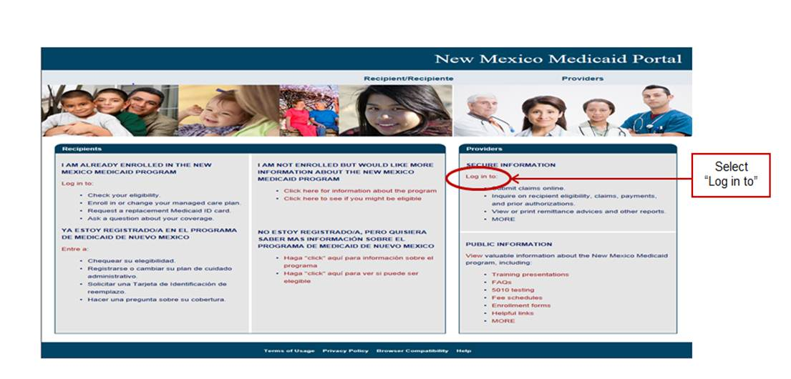
New Mexico Medicaid Portal

Slide 5
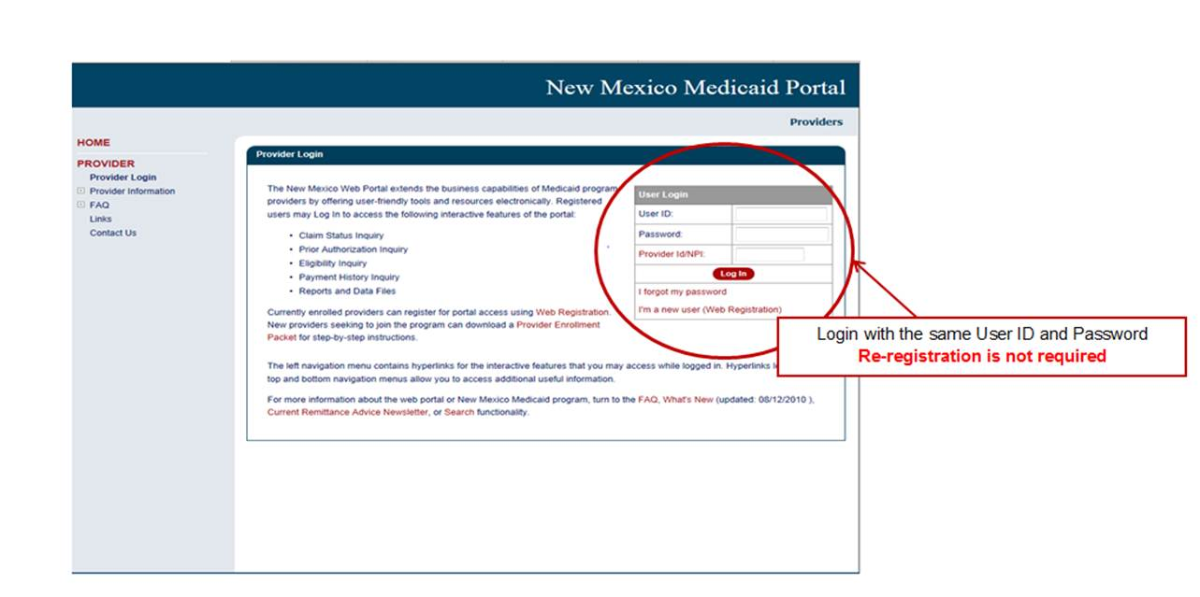
Web Portal- Login

Slide 6
Important State Websites
STATE WEBSITE:
PROGRAM POLICY MANUAL
  http://www.hsd.state.nm.us/mad/policymanual.html
BILLING INSTRUCTIONS
  http://www.hsd.state.nm.us/mad/billinginstructions.html
REGISTERS AND SUPPLEMENTS:
  http://www.hsd.state.nm.us/mad/registers/2012.html

Slide 7
Transaction Control Number
Conduent
Government Healthcare Solutions

Slide 8
What is a Transaction Control Number (TCN)?
The TCN is a unique number assigned to each and every claim
This number contains information about the claim and can be used to identify your claim when calling provider services
91325900085000001

Slide 9
What is a Transaction Control Number (TCN)?
91604900085000001
The twelfth digit in an adjustment/ void TCN will either be:
1= Debit
2= Credit
The first digit indicates what the claim “media” is:
2 = electronic crossover
3 = other electronic claim
4 = system generated claim or adjustment
8 = paper claim
9 = Web portal claim entry
Batch number
The last two digits of the year the claim was received
The numeric day of the year.
The claim number within the batch.
This is the Julian Date - this represents the date the claim was received by Conduent: this claim was received the 49th day of 2016, or February 18, 2016
Notes:
Global slide – indicate somehow

Slide 10
Completing a Reconsideration Form
Conduent
Government Healthcare Solutions

Slide 11
When to Complete a Reconsideration Request
Proof of timely filing for repeated untimely filing denials with extenuating circumstances
Proof of non-duplicate service for an initial duplicate denial
Response to the fiscal agent’s requests for additional information regarding a previously denied claim (only when instructed by the fiscal agent)

Slide 12
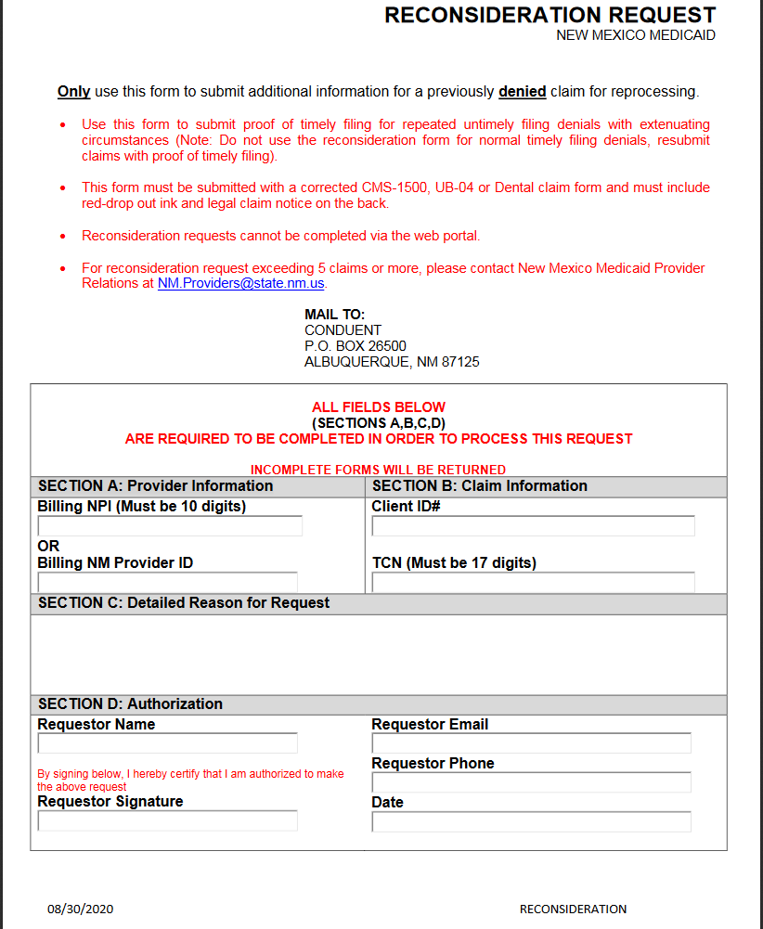
Reconsideration Request Form

Slide 13

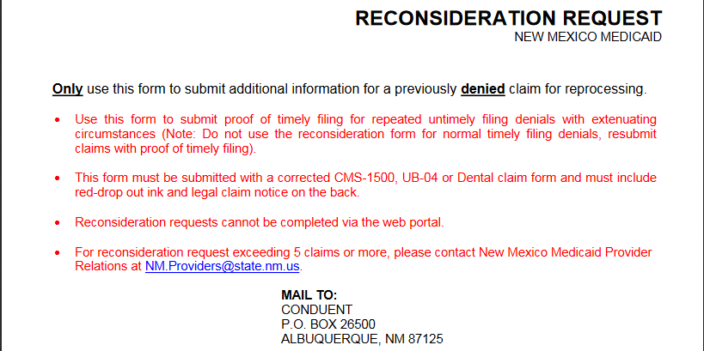

Reconsideration Request Form

Slide 14
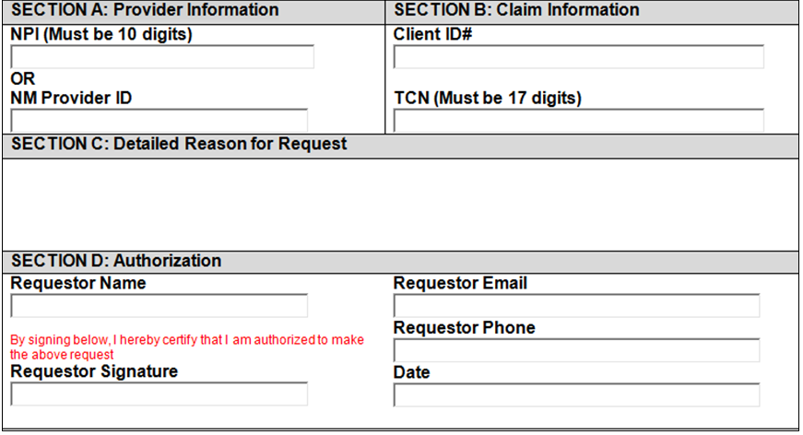

Reconsideration Request Form
Fill in the following:
NPI
Or
NM Provider ID
Required
Required
Required
Provide information regarding why this request needs to be reconsidered
Required
Required
Required
Required
Required

Slide 15
Which Scenarios Would be Considered Reconsiderations?
  Scenario #1
  Medicaid denied the claim for Exception code 0101- Service dates within Centennial Care Enrollment Period. The patient was admitted on 09/03/17 and has not been discharged. The patient became eligible with Presbyterian Healthcare Services Centennial Care after the admission date.
  The provider would like us to override the 0101 denial and reprocess the claim for payment.
  Reconsideration?
  NO – On the CMS-1500 if Box 18 is completed (Hospitalization Dates Related to Current Services), the system will bypass this edit. No Reconsideration is required.
Notes:
Further explain details of the scenario. What will happen if a reconsideration request is received for this scenario.

Slide 16
Which Scenarios Would be Considered Reconsiderations?
Scenario # 2:
A Third Party Liability (TPL)\SALUD retracted their payment on 03/27/2017. Per the Medicaid Web Portal, the patient is Medicaid eligible on DOS. The provider attached the claim form and the TPL\CCO retraction EOB for proof of timely filing.
The provider would like the 2 year timely filing limit overridden.
Reconsideration?
YES – Since the payment to primary payer was recently retracted and provider is submitting within 90 days from the date on the Retraction EOB, this can be reconsidered for timely filing.
Notes:
Address timely filing guidelines. We can’t override 2 years.

Slide 17
Which Scenarios Would be Considered Reconsiderations?
Scenario # 3:
The provider submitted a claim (DOS 08/30/16) on 09/12/2016, the claim denied on 10/19/2016 for missing Prior Authorization number. The provider resubmitted the claim with Prior Authorization number and a Reconsideration form on 3/15/17, asking for timely filing to be overridden.
The provider would like timely filing to be overridden.
Reconsideration?
NO – The provider did not re-submit the corrected claim within the (one time) 90 day timely filing grace period .

Slide 18
Which Scenarios Would be Considered Reconsiderations?
Scenario # 4:
The provider submitted a claim with dates of service 12/24/2016 and attached an EOB payment from the primary payer dated 3/14/2017.
The provider is requesting to override timely filing.
Reconsideration?
YES – The provider can submit a reconsideration due to receiving the EOB with a payment from primary payer and submitting to NM Medicaid within 90 days of the payment date of that primary payer EOB.

Slide 19
Remittance Advice EOB Code
The following EOB code will be on Providers Remittance Advices if any reconsideration has denied.
0879 (Reconsideration Request) - Your request for reconsideration has been reviewed and denied.
If a submitted Reconsideration processes and pays, the claim will have a “Paid” status reflected on their Remittance Advice.

Slide 20
When is it Necessary to Fill Out an Adjustment Form for a Claim
Conduent
Government Healthcare Solutions

Slide 21
Adjustments
Claims paid incorrectly must be adjusted
DO NOT resubmit a denied claim with an adjustment sheet attached

Slide 22
Adjustments
Adjustments will not be considered unless submitted on the adjustment request form with the below included.
Corrected claim
TCN indicated on claim form for timely filing review
  CMS 1500 form: Put the TCN in block 22 on the paper form. Leave the “Code” blank, and put the TCN in the “Original Reference No.” field
  UB Form: Put the TCN in Form Locator 64 “Document Control Number” (DCN) matching the appropriate payer line, using a paper form
  Dental Claim Form: Enter the TCN number in Box 35 beginning on the left side

Slide 23
Adjustments
Requests to adjust a claim must be submitted within 90 days from the date on the RA for the paid claim
Always fill out the corrected claim (replacement claim) exactly as the claim was originally filed with the exception of the information being changed

Slide 24
Completing an Adjustment Form
Conduent
Government Healthcare Solutions

Slide 25
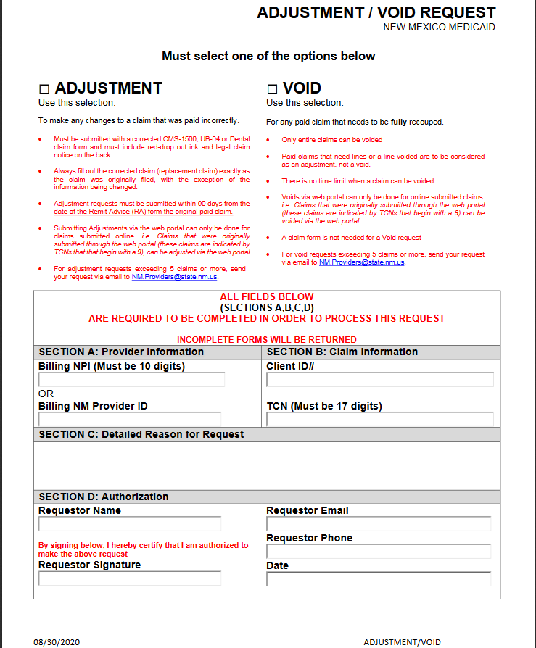
Adjustment Request Form

Slide 26
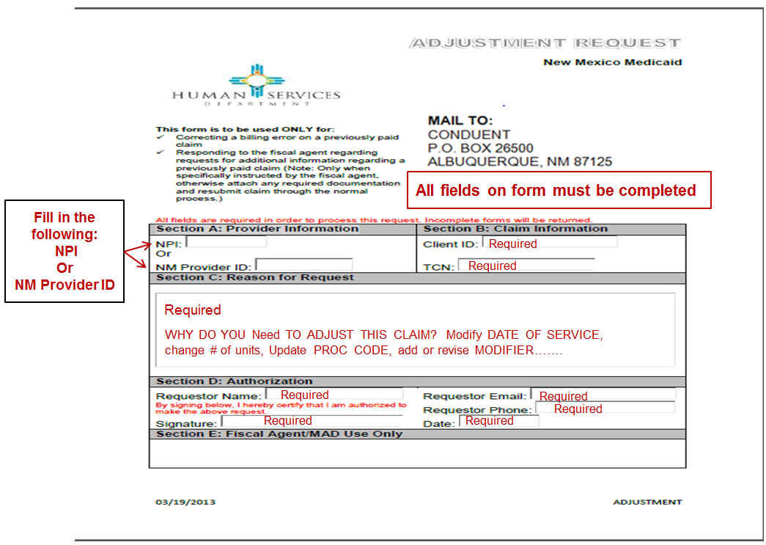

Slide 27
Adjustments – Filing Guidelines Recap
Complete Adjustment form
Fill out corrected claim (CMS1500, UB04, or ADA 2006)
Complete all information as it was on the claim previously submitted, with the exception of the changes being made
Mail to Conduent PO Box 27460 Albuquerque, NM 87125-7460, Attn: Claims Adjustment (keep a copy for your files)

Slide 28
Completing a Void Form
Conduent
Government Healthcare Solutions

Slide 29
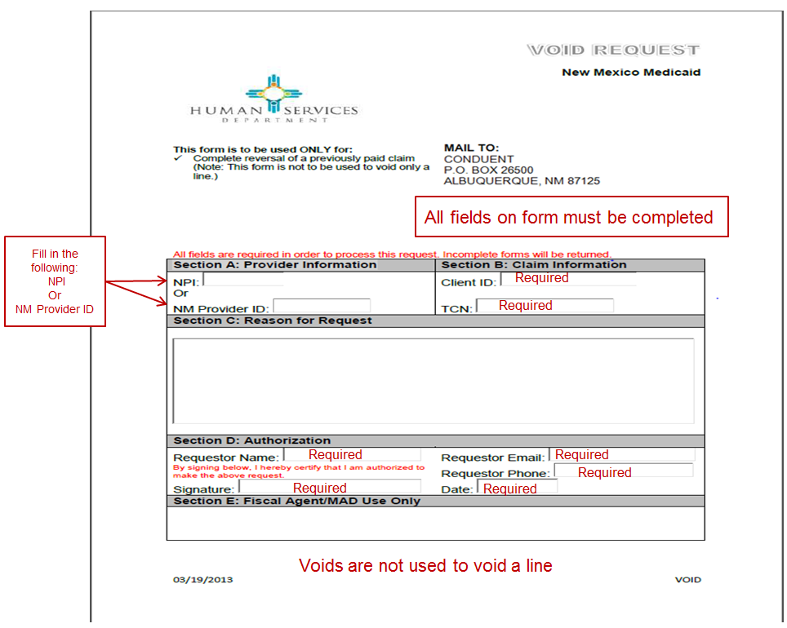

Slide 30
Voids
There is no time limit on when a claim can be voided
If the intent is to have a previously paid claim adjusted, you will have to adhere to the claim adjustment timely filing guidelines

Slide 31
Request Form Instructions
Conduent
Government Healthcare Solutions

Slide 32
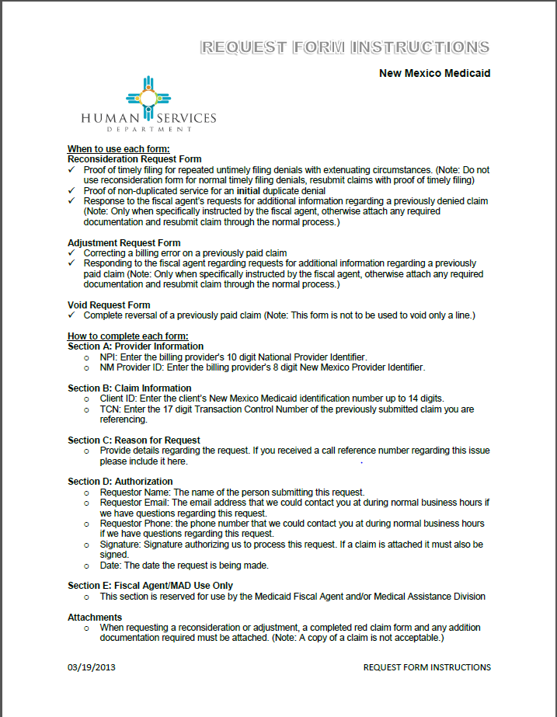
Request Form Instructions

Slide 33
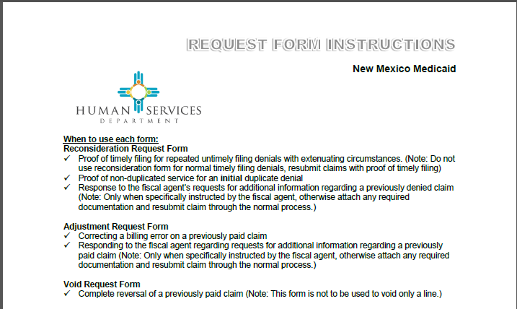
Request Form Instructions

Slide 34
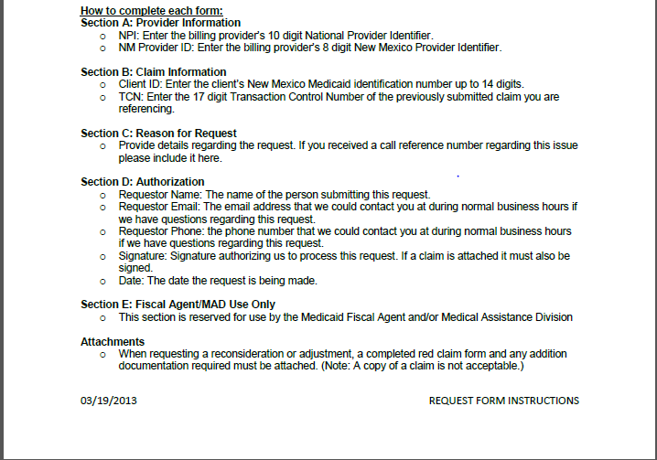
Request Form Instructions

Slide 35
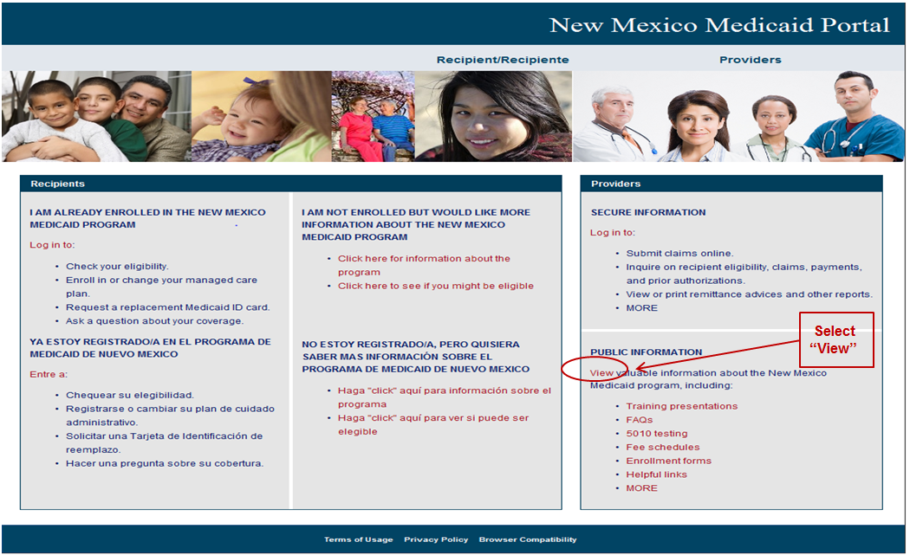
Forms on the Web Portal

Slide 36
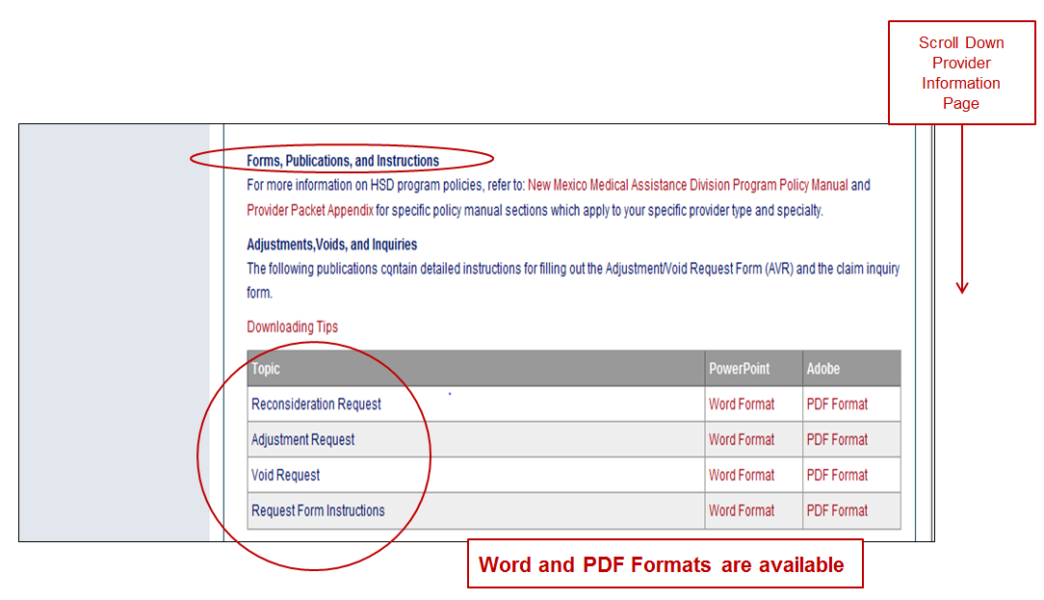
Forms on the Web Portal

Slide 37
Resources
When online use: Ask Service Representative
hipaa.desknm@state.nm.us
NM.Providers@state.nm.us
Call Center 800-299-7304
  New Mexico Web Portal
    Provider Information section
    Links and FAQ section
    Provider Login section

